Slide 1

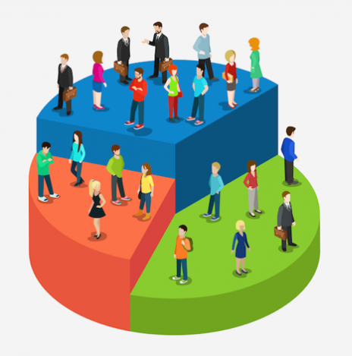



Customer Segmentation
Understanding and Categorizing Customers for Better Decision-Making
Prepared by :-
Darji Sahil
24002170120002

Slide 2
TABLE OF CONTENTS
01
02
03
Introduction
Tech Stack used
Features

Slide 3
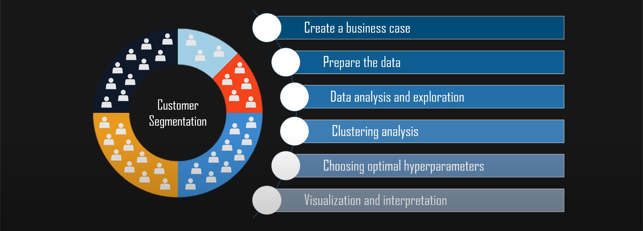
About this project

Slide 4
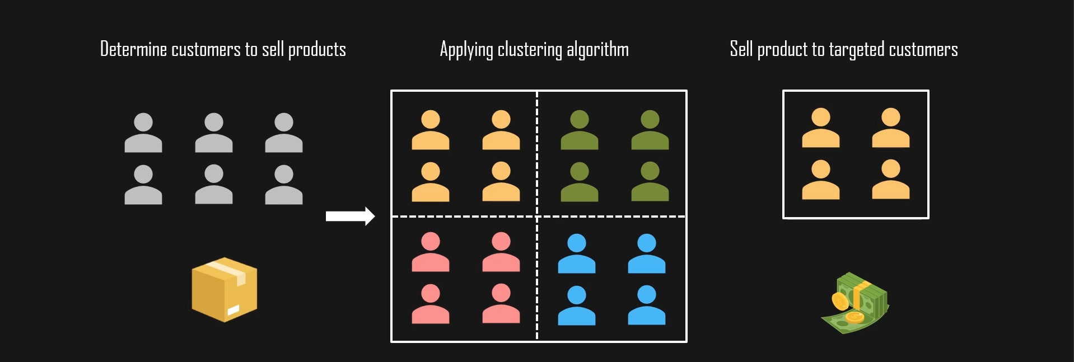


What is customer segmentation??

Slide 5

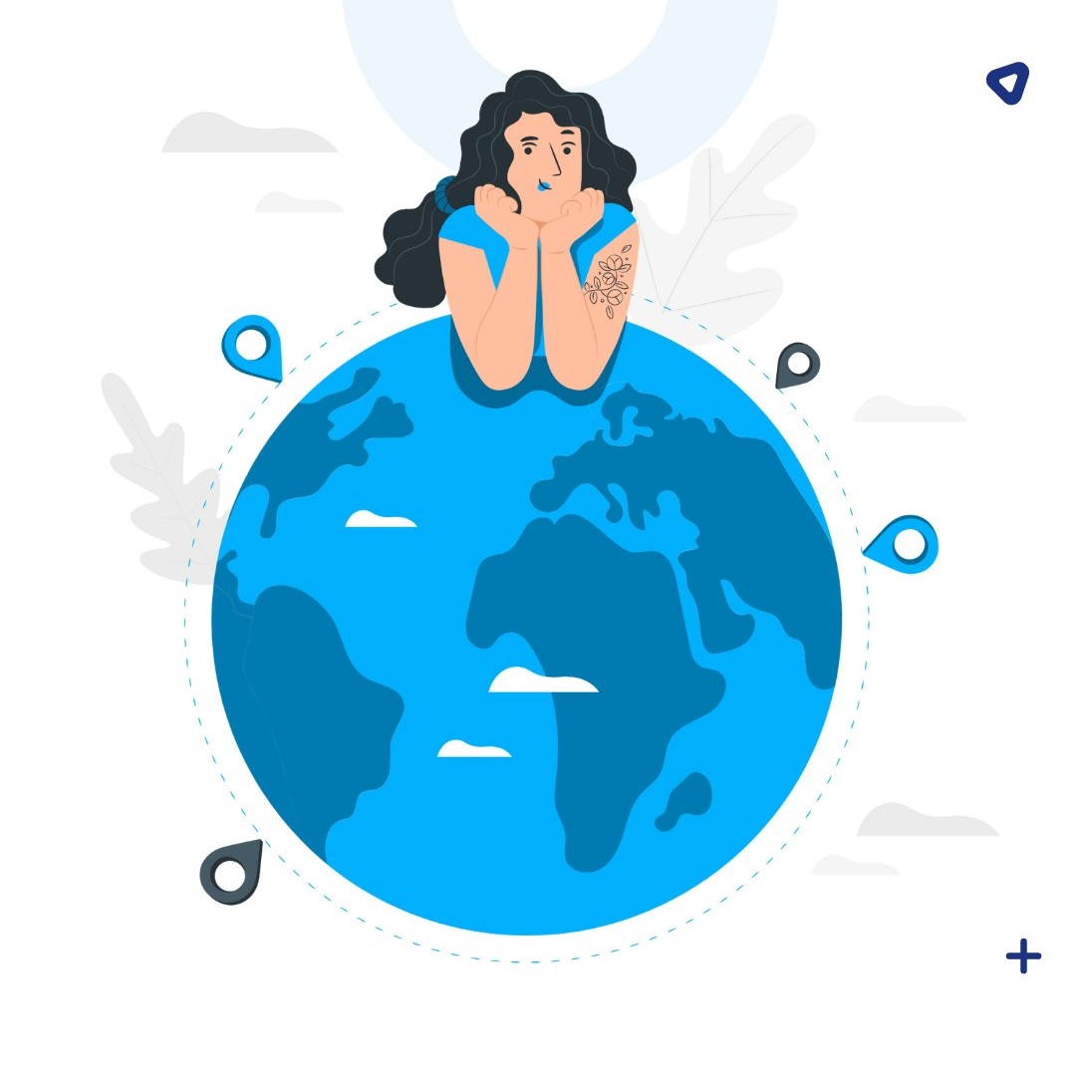
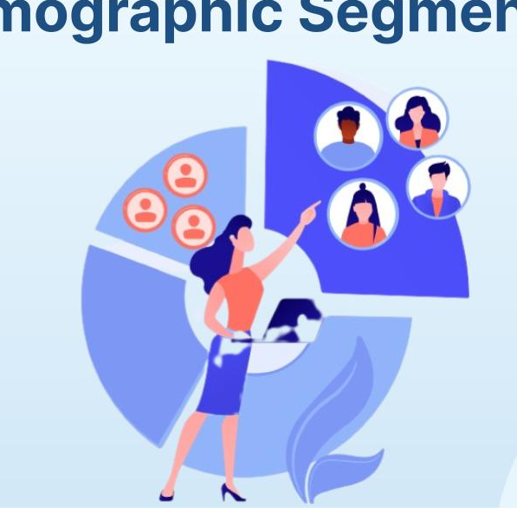




Types of Customer segmentation
Demographic Segmentation
Geographic Segmentation
Behavioral Segmentation

Slide 6

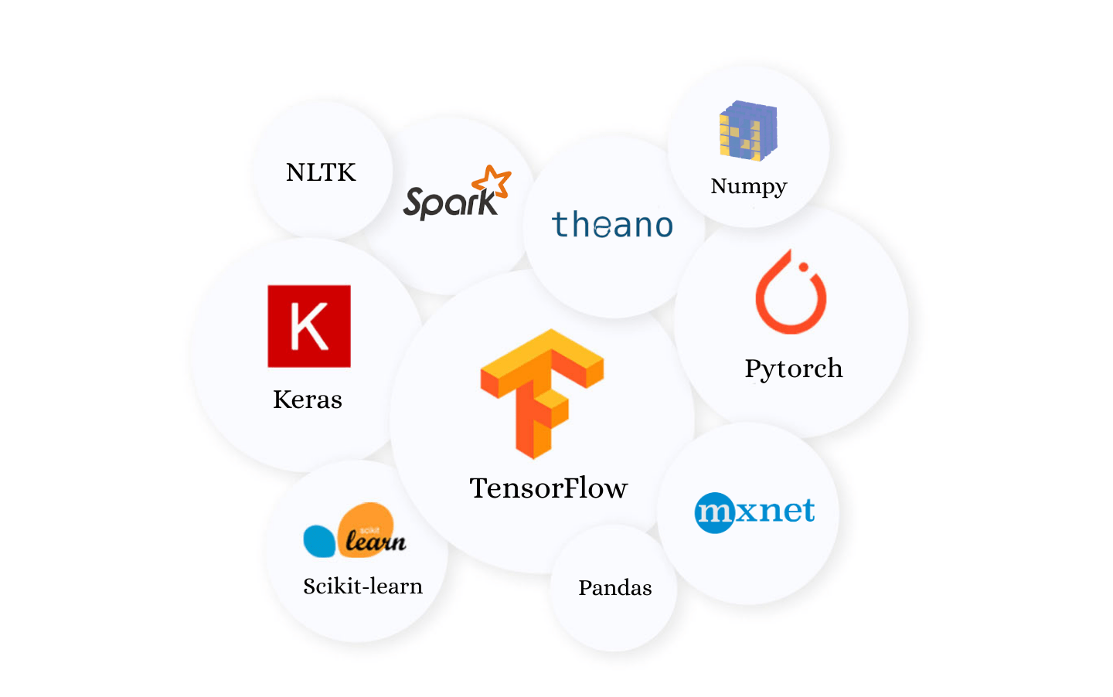
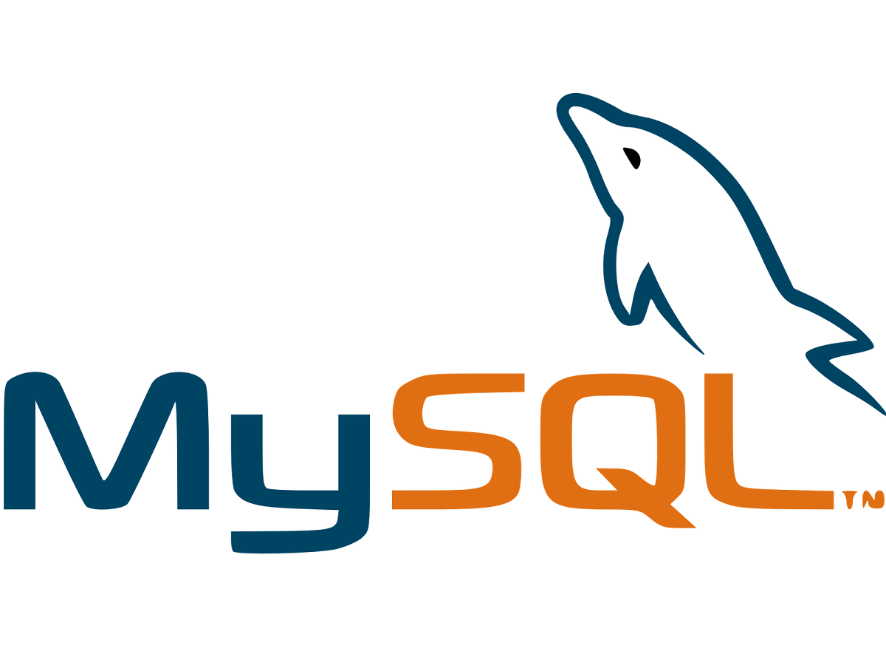

Technology used
Python
Database
Environments and tools
Pandas
Numpy
Sklearn
Matplotlib
Kmeans
For connect .py file to databse
MySQL

Slide 7
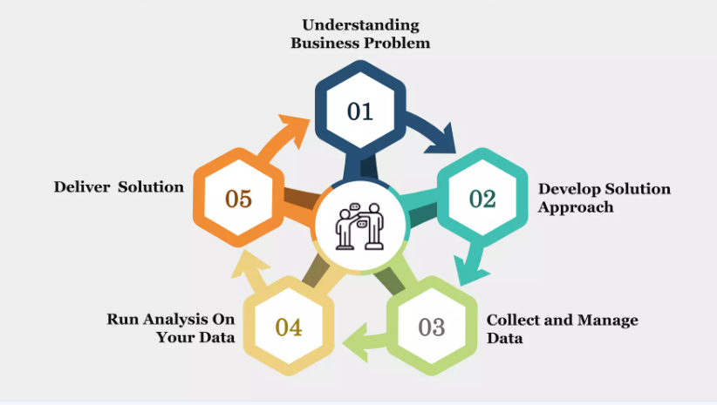
How does customer segmentation work ?

Slide 8
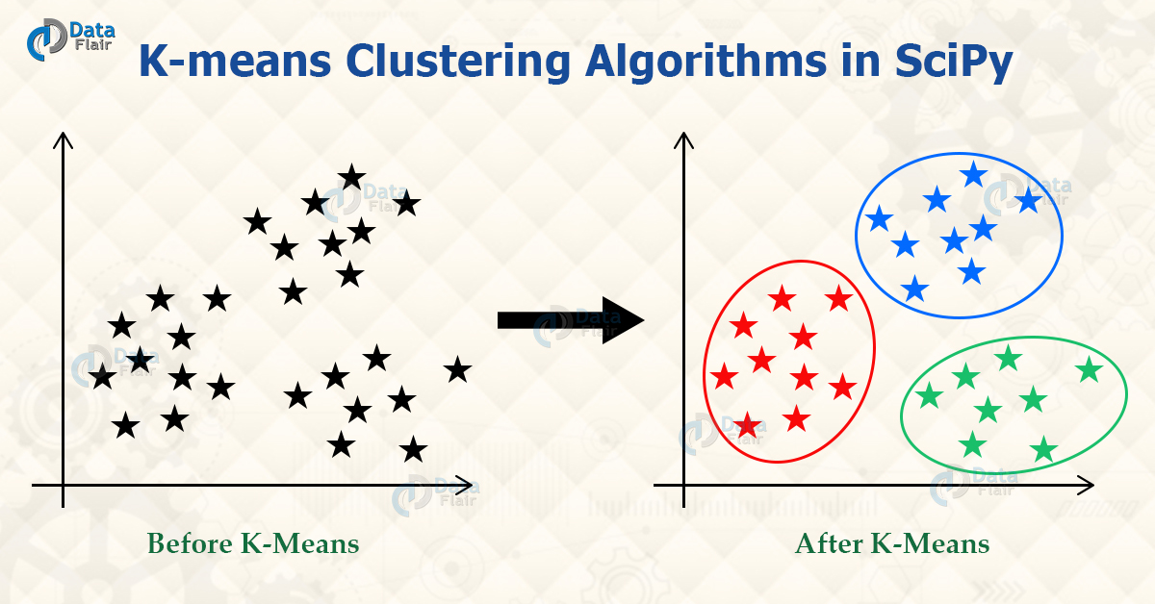
Why k-means clustering
K-means clustering is a technique used to organize data into groups based on their similarity.
For example, online store uses K-Means to group customers based on purchase frequency and spending creating segments like Budget Shoppers, Frequent Buyers and Big Spenders for personalized marketing.

Slide 9






Advantages of Customer segmentation
Price optimization
High
success rate
Brand awareness
Know your customer better

Slide 10
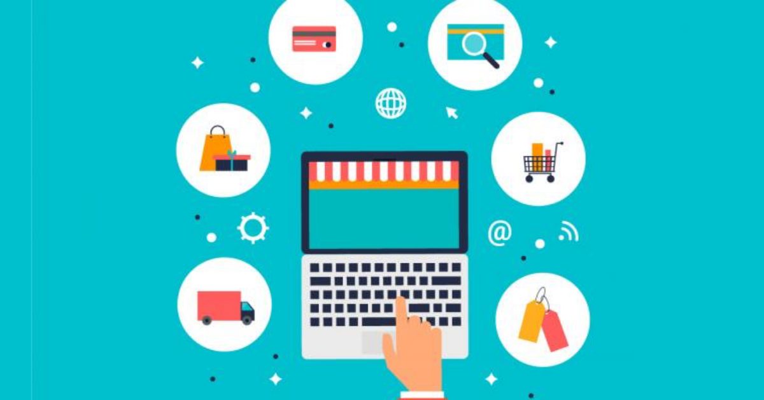
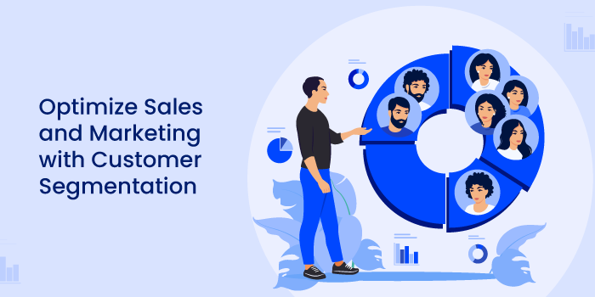

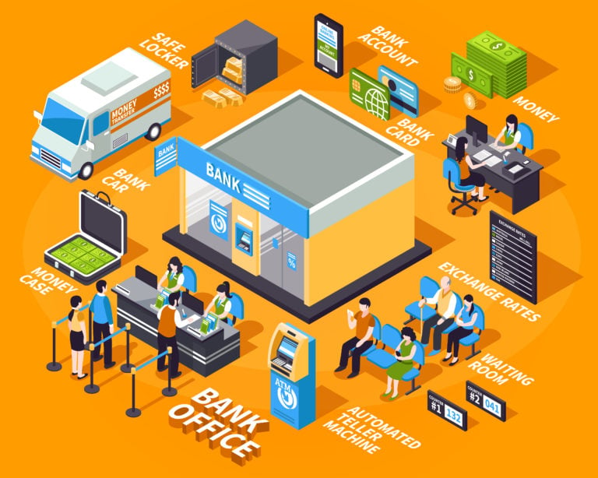
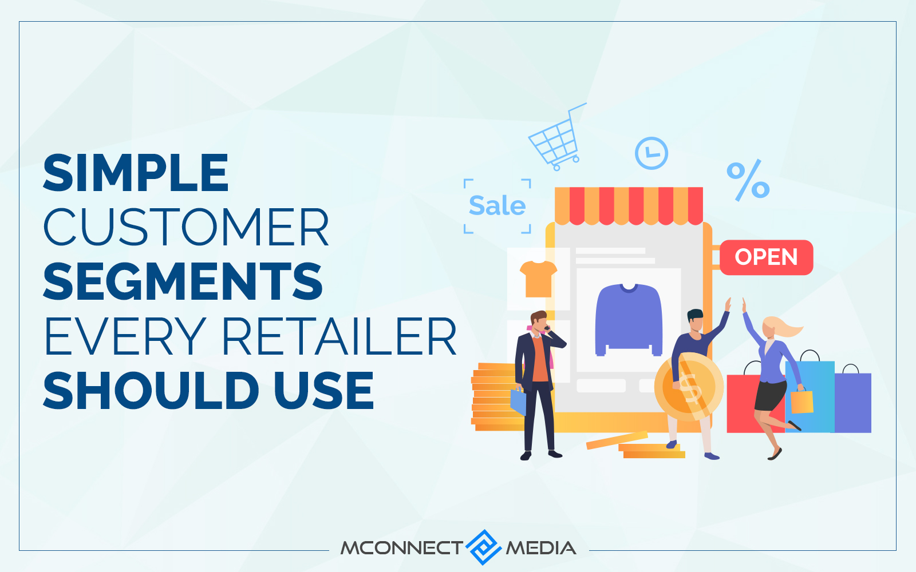


Real-World Applications
E-commerce
Healthcare
Personalized product recommendations..
Patient segmentation for better treatment..
Banking
Retail
Risk assessment & fraud detection..
Customer loyalty programs based on buying patterns.

Slide 11
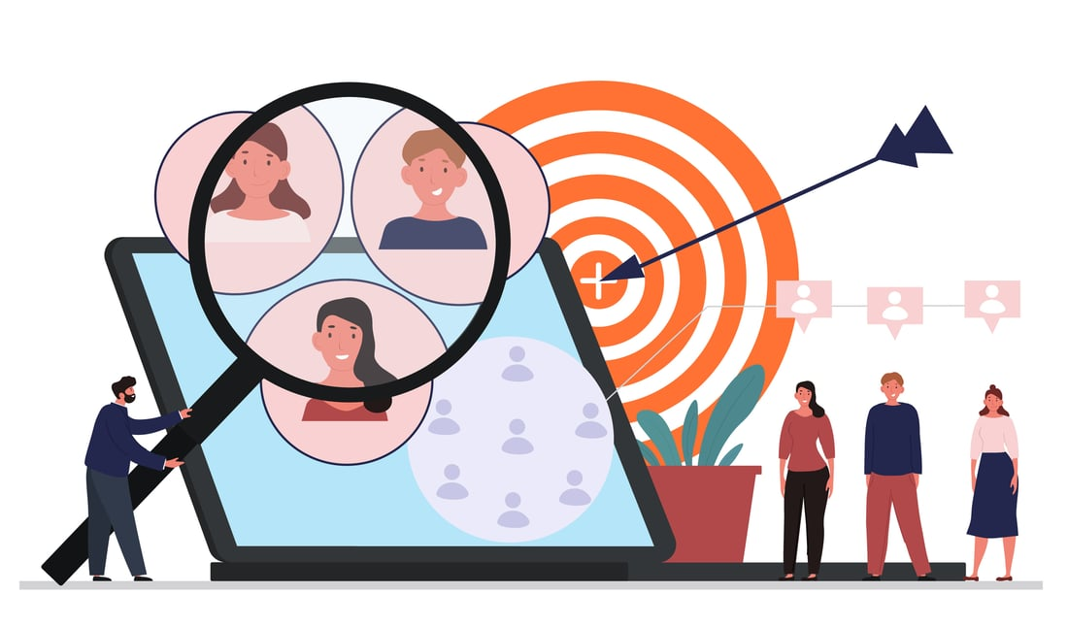
Conclusion
Customer segmentation helps businesses make informed decisions.
It improves marketing effectiveness and customer satisfaction.
With AI & machine learning, segmentation is becoming more precise and impactful.

Slide 12
Thank you !

